Slide 1
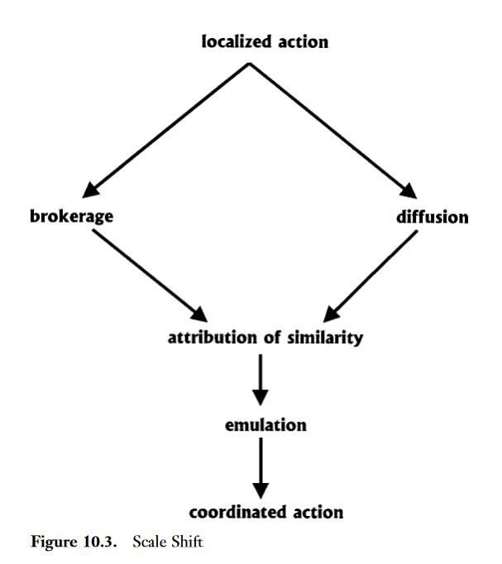
Process of scale shift in political contention. (explain “how to” process)
Source: McAdam, Doug, Sidney Tarrow, and Charles Tilly. 2001. Dynamics of Contention. Cambridge: Cambridge University Press, 333.

